Slide 1
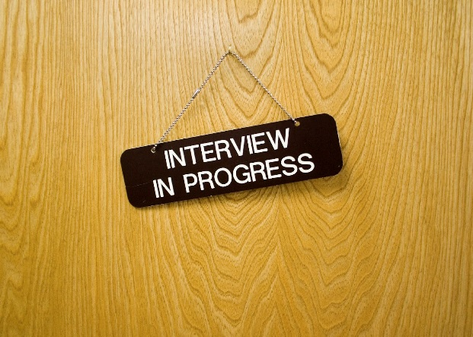

Interviewing

Slide 2
Purpose of an interview
For the Employer
Why should they hire you instead of someone else?
What can you do for their company and employees?
Does your personality fit in with their office dynamic?
For YOU
Sell your strengths & skills through stories about your experience.
Research the company and job to see if it would fit you.

Slide 3
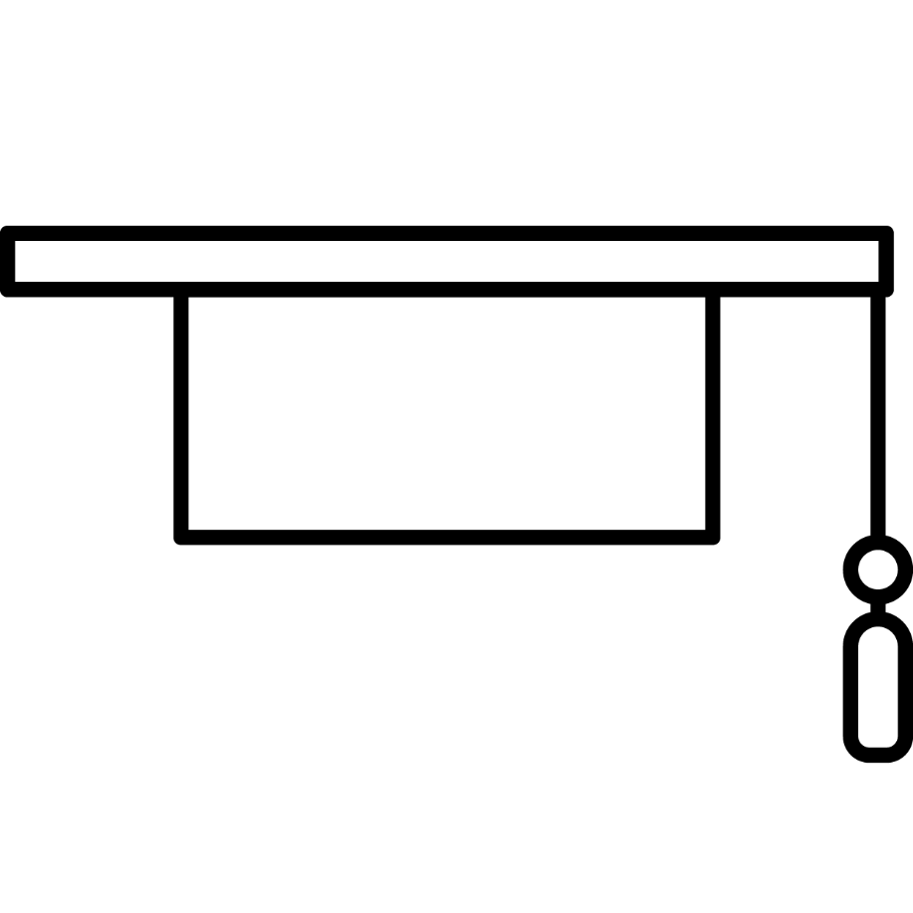



Career Competencies Employers Want
Critical Thinking
Communication
Leadership
Career & Self Development
Critical Thinking
Communication
Leadership
Professionalism
Teamwork
Technology
Equity & Inclusion
Career & Self-Development
Equity &
Inclusion
Technology
Professionalism
Teamwork
Adapted from What is Career Readiness? (naceweb.org)

Slide 4

Preparing for the interview
Research the company & industry.
  Review the company website, recent news stories, online reviews, etc.
Study the job description carefully.
  Be familiar with the key skills needed & how your skills relate.
Know who you would report to if hired.
  It’s impressive when you know names of potential co-workers, and their titles.
Do a Google search for interview questions for the title of the position you applied for.
  Go through them, write down how you might respond to each of the questions, and study this prior to your interview.

Slide 5
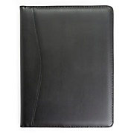
If In Person…
Have your clothes cleaned and ready the day before the interview.
  You don’t want to feel rushed the day of your interview.
Familiarize yourself with the interview place’s location.
  Being late to an interview may automatically disqualify you.
Have a portfolio with extra copies of your résumé.

Slide 6

IF Over the Phone…
  Have notes neatly organized and in front of you in case you need them.
  Ensure your phone is charged.
  Be prepared to answer a phone call from a number you don’t recognize.

Slide 7

Most Importantly…
Schedule a mock interview with your Professional Development Specialist
in Gators4Hire!

Slide 8
What to Wear – FEMALE
Suit: Conservative suit in navy, black, or grey. If wearing a skirt, it should be knee-length.
Blouse: White or light-colored blouse that is not low-cut or sheer.
Shoes: Black, well polished, closed-toe shoes with a low heel. Neutral-colored, closed-toe flats are also acceptable.
Accessories: Leather portfolio or briefcase large enough to hold your résumé without folding it. No visible body art or piercings other than one earring per ear. Wear minimal jewelry.
The Look: Tailored, clean and neat; not overdone.
Notes:
If you don’t have a suit, a conservative pencil skirt with a blazer is also acceptable, or a nice dress with a blazer on top.
Blouse –Color is acceptable, as long as it’s a solid color and not patterned.
Shoes –Don’t have to be black, but neutral in color (navy, nude, grey).
Minimal jewelry –Simple necklace, watch, stud earrings, 1-2 rings.
No wrinkled clothing!

Slide 9
What to Wear – MALE
Suit: Conservative 2 or 3 button suit in navy, black, or charcoal. Jacket and Pants should be the exact same material.
Shirt: White cotton long-sleeve dress shirt.
Tie: Silk tie that complements your shirt and suit. Simple stripe or design.
Shoes: Black, well polished, leather shoes. Wear black socks.
Accessories: Leather portfolio or notebook large enough to hold your résumé without folding it.
The Look: Sharp, conservative, clean and neat.
Notes:
If no suit, a nice pair of dress slacks with a button-down and blazer is acceptable. Pay attention to material.
Shirt does not have to be white, but should be light in color.
No wrinkled clothes!

Slide 10
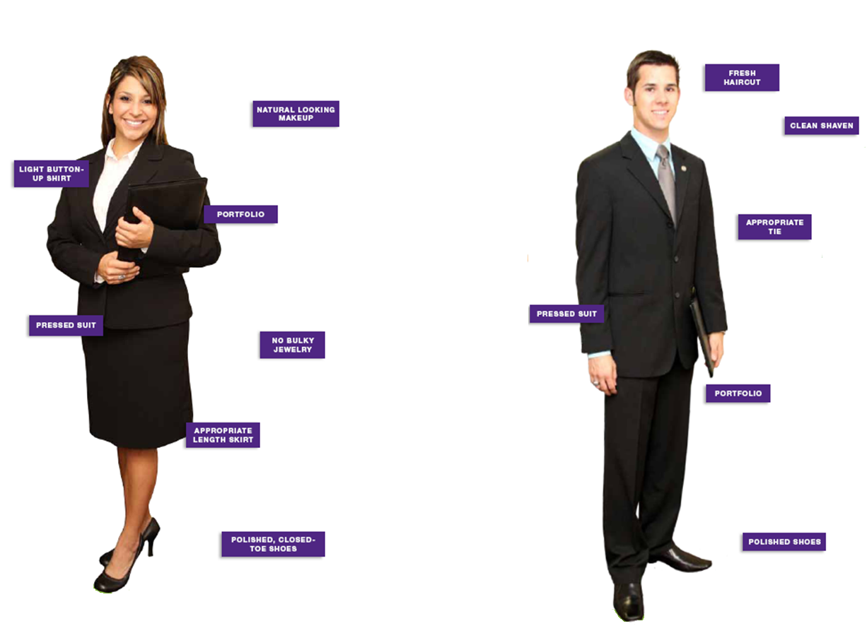

Slide 11



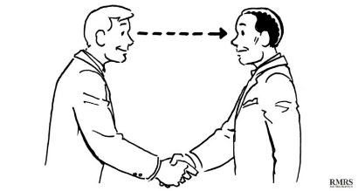
DURING THE interview
  PHONE
  SMILE!
    The employer will be able to hear the difference in your voice.
  Dress for the interview.
    You need to ‘feel’ like you are there.
  Avoid distractions.
    Close the door to the area you use.
  Use & Take Notes.
  Get contact information so you can follow up!
FACE-TO-FACE
Shake hands firmly, and smile upon greeting your interviewer(s).
Be aware of what your body language is communicating.
  Project confidence - Sit up straight; smile.
  Use hands sparingly.
Make and hold eye contact during conversation.

Slide 12
TOUGH BUT COMMON Interview Questions
“Tell me about yourself.”
  Focus on education and work.
  Express positive feelings about your studies and work.
  Tell the interviewer(s) why you applied for their position.
“What are your strengths and weaknesses?”
  When talking about your weaknesses, express ways in which you are working to improve these areas.
“Where do you see yourself in five years?”
  Expressing a desire for leadership within their agency is your best bet.
“Why should we hire you?”
  Think about the job qualifications, and share the qualifications you possess. Remind them about your education, relevant experience, and why you are a good fit for their organization.

Slide 13
COMMON Interview Questions, Continued…
  “Tell me about a time you experienced a conflict and how you handled it.”
    Everyone has had a conflict! How did you display maturity and professionalism when handling the situation?
  “Tell me about a time you worked as a team to accomplish a goal.”
    What is your role when working with others? Are you a team player?
  “Give me an example of when you tried to accomplish something and failed. What did you learn from the experience?”
    Everyone has failed at something. Provide an example – it shows your humility.
  “Tell me about a time when you had multiple projects to work on at once. How did you prioritize your tasks?”
    Employers want to see your ability to organize, exercise sound judgement, and problem solve.

Slide 14
Interview Tips
Listen to entirety of interviewer’s question.
  Don’t interrupt with an answer before they finish asking the question.
If you’re having a hard time answering a question, it is acceptable to ask the interviewer for a moment to think about a response rather than sit in silence.
If you do not understand an interviewer’s question, you should ask for clarification.
  This is better than giving a response that isn’t applicable to the question.
Always ask questions after the conclusion of your interview if given the chance!
  “What qualities would an ideal person for this job have?”
  “What do you like or dislike about working for this company?”
Before leaving, re-express your interest in the job, and tell the interviewer why you feel you are a good fit for their company/position.
DO NOT ASK ABOUT SALARY INFO AT YOUR INTERVIEW!
  Wait until you’ve secured the job before beginning salary negotiations.
FOLLOW UP!
  Send a thank-you note/email within 24 to 48 hours of your interview.
  Try to find a subject of interest that was discussed in your interview, and mention it in the thank-you to show that you were paying attention.
Notes:
Ask about the next steps in the hiring process – it shows you’re still interested in the job after meeting your interviewers!
Salary negotiations:
Texas Reality check
Monster Salary Wizard
http://monster.salary.com/SalaryWizard/LayoutScripts/Swzl_NewSearch.aspx
Go to Monster.com
Click on Career Resources
Click on Additional Resources
Click on Salary and Benefits
Scroll down until you see Get More Help With Your Job Search
Click on Salary Calculator
You can always counter-offer but be able to back it up with a reason such as prior experience, contacts that will be helpful, etc. (consider the industry as some industries and companies do not have as much wiggle room as others).

